Slide 1
Mastering PowerShell: A hands-on lab working with APIs
Devin Rich
@Szeraax

Slide 2

Keep this here and replace it with the update sponsor image that will be sent out the week prior to summit

Slide 3
Setup
Go to https://summit.dcrich.net
Create an account
Open PowerShell Core (v7) on your machine

Slide 4
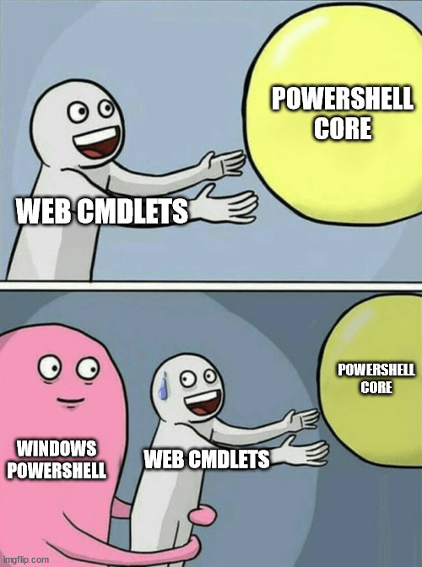
Use
Pwsh

Slide 5


Slide 6

Devin Rich
Github
Discord
Slack
Twitter
Gmail
@Szeraax

Slide 7
Why bother with APIs when we have modules?

Slide 8
Standardization

Slide 9
Method
Endpoint
Path/Route
Query string
Header
Body content
Status code

Slide 10

API Standards

Slide 11
< INSERT LAB >

Slide 12


Slide 13


Slide 14
What about AI?

Slide 15

THANK YOU
Please review this session

